Slide 1
Squaring the Rectangle

Slide 2
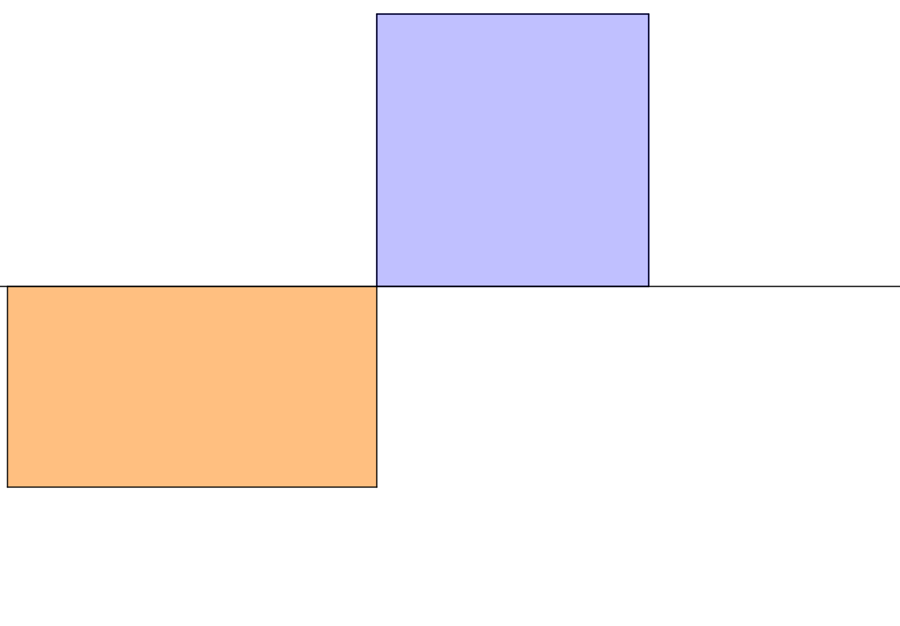
Squaring the Rectangle
Square
Rectangle
Convince yourself that the two quadrilaterals have the same area.

Slide 3

Given a rectangle such as this how would you construct the square of the same area?
Keep watching to get some clues!

Slide 5
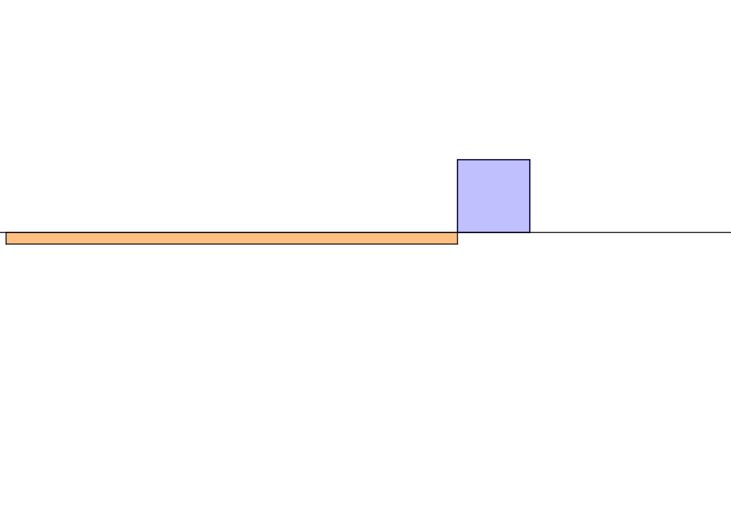

Slide 6
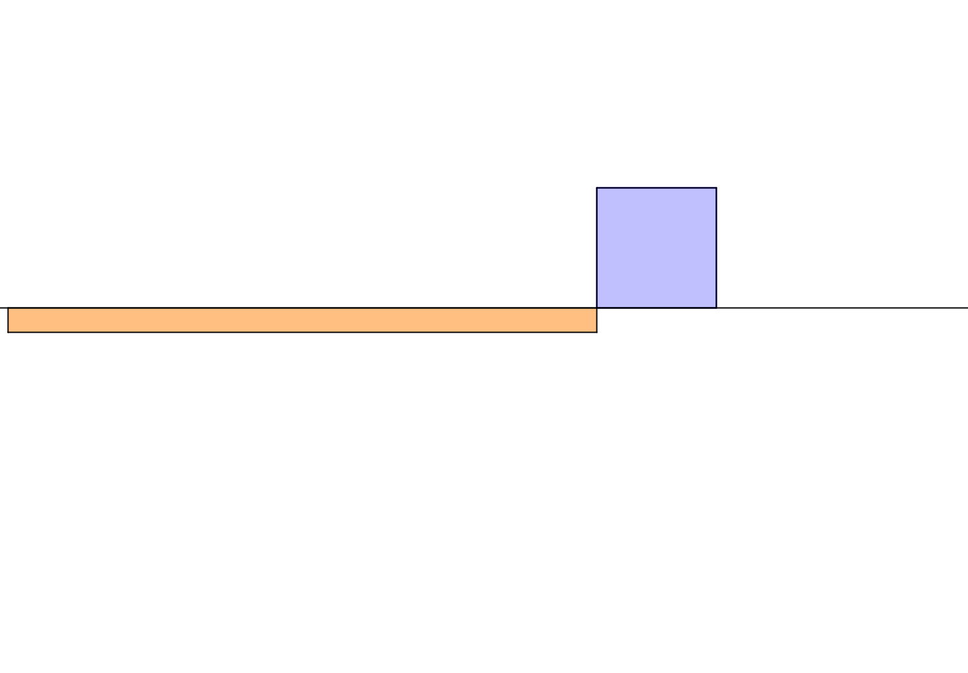

Slide 7
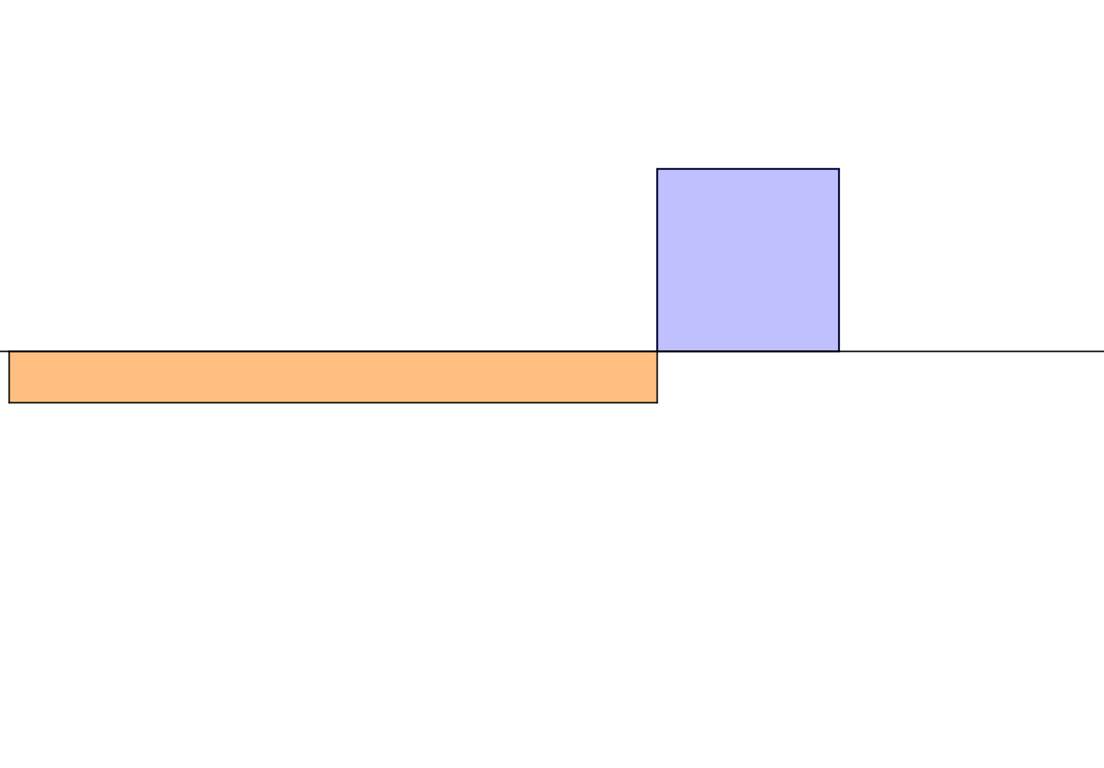

Slide 8
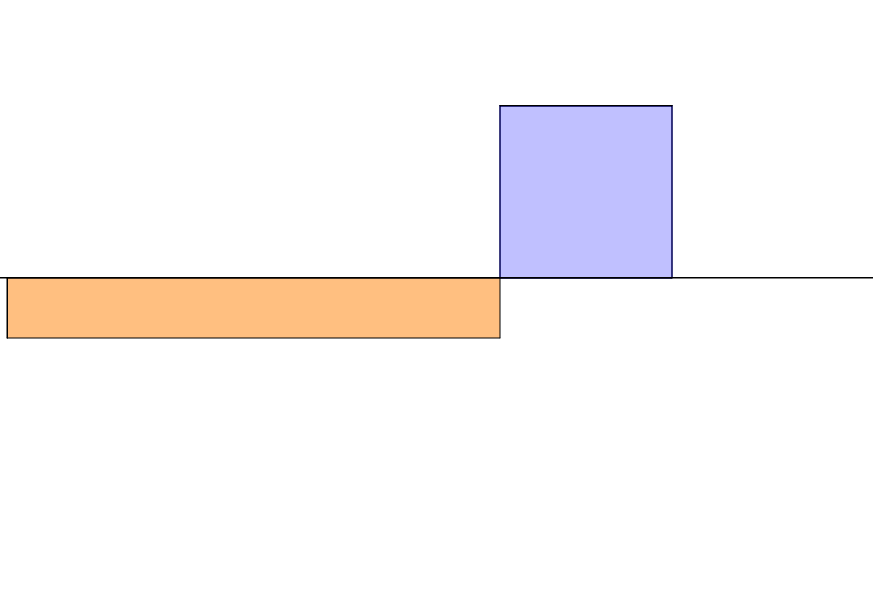

Slide 9
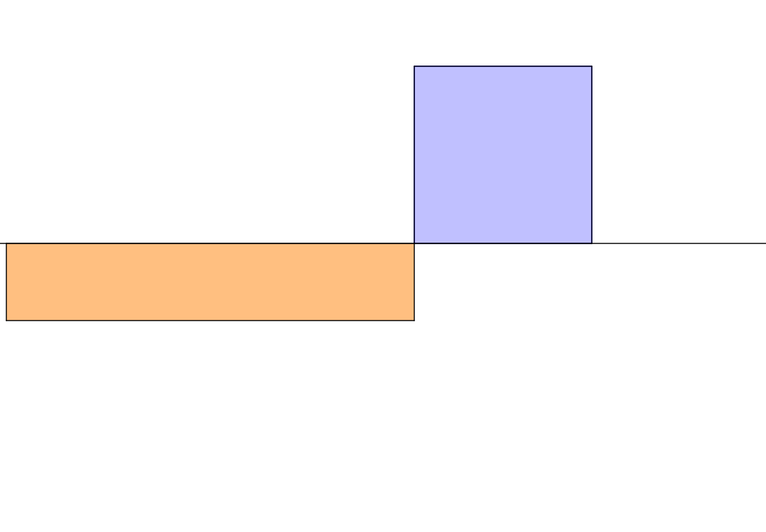

Slide 10
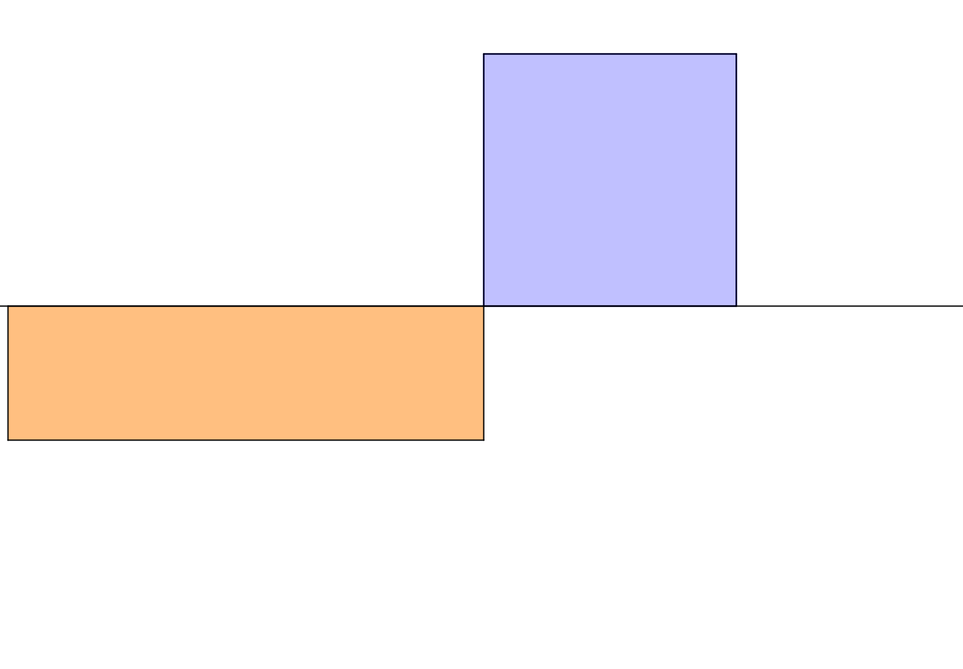

Slide 11
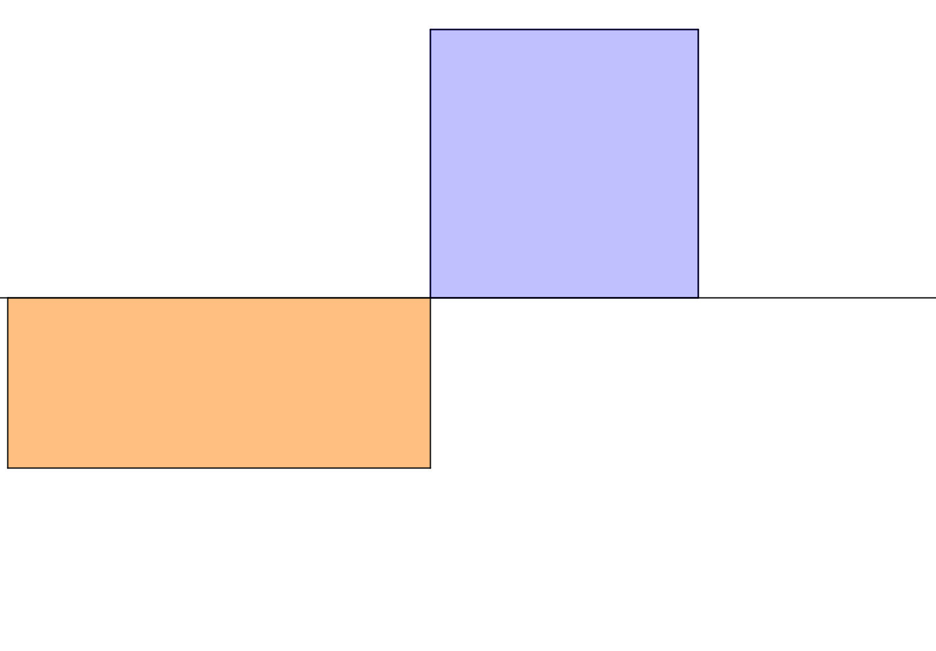

Slide 13
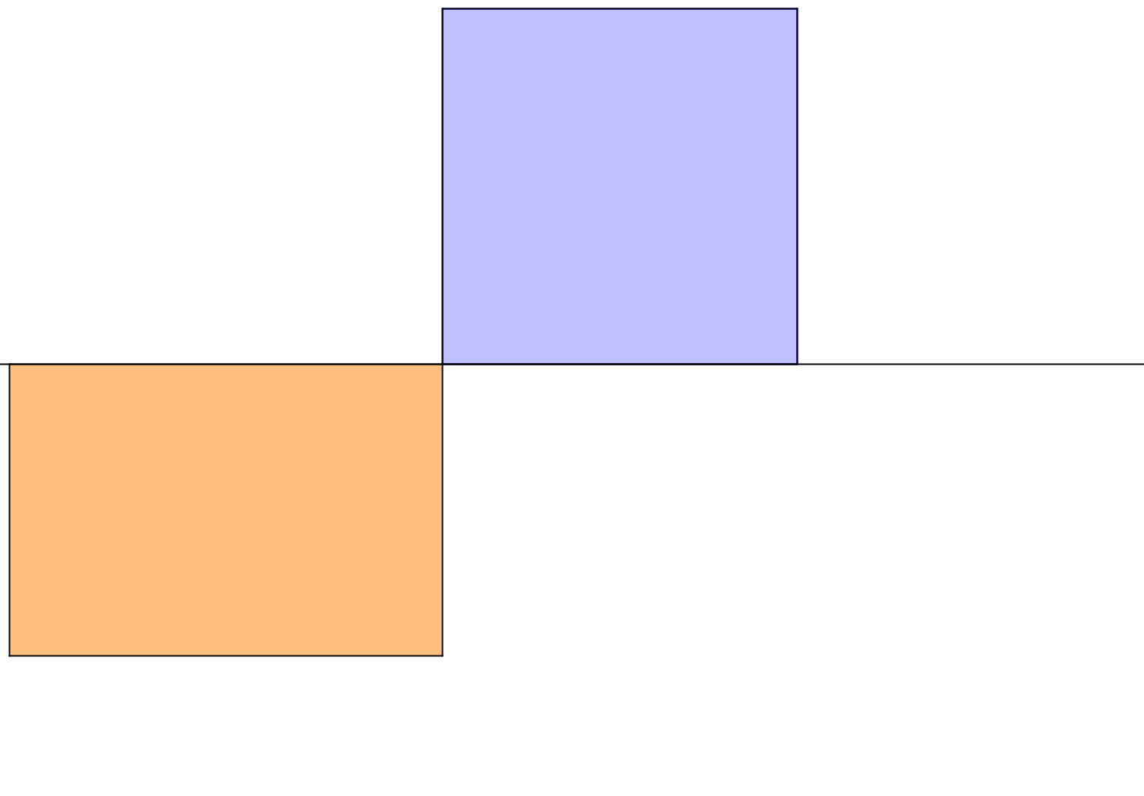

Slide 14
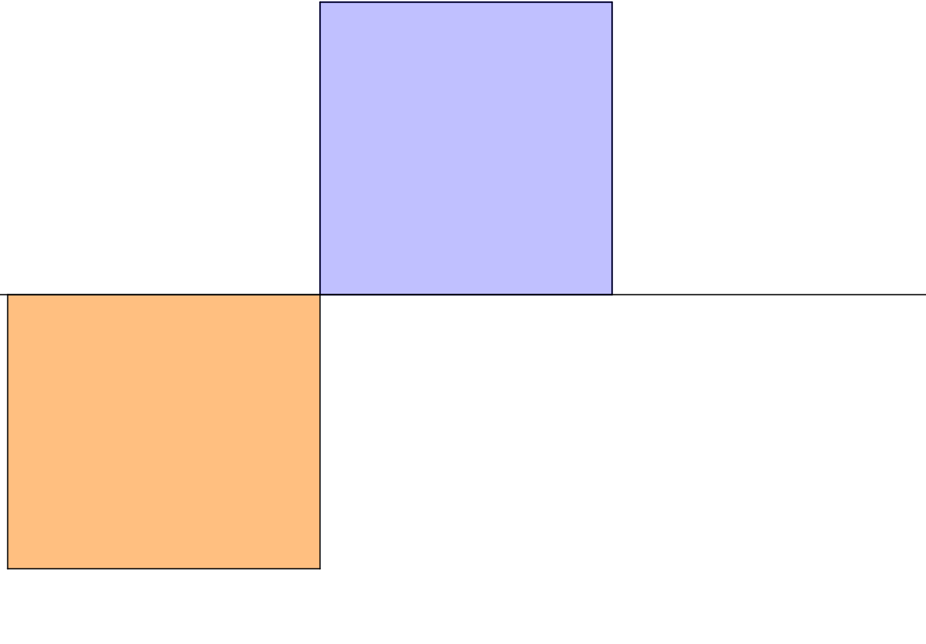

Slide 15
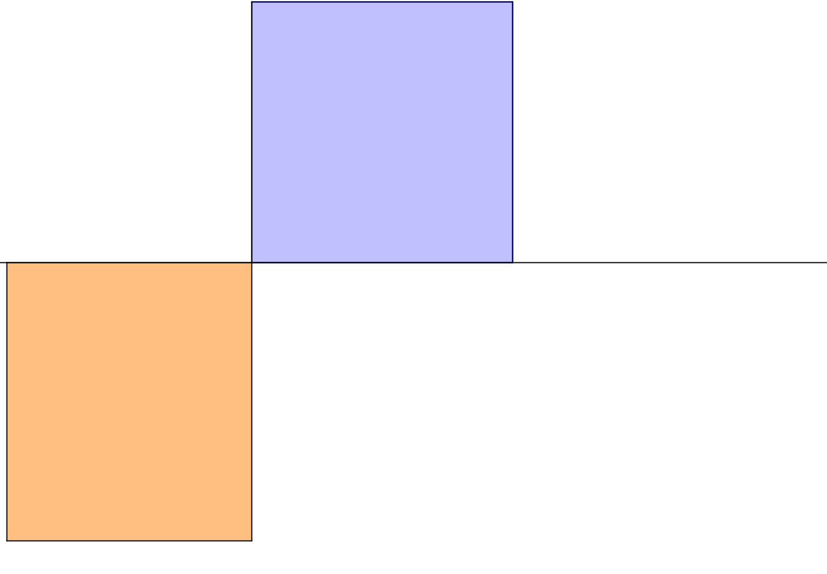

Slide 16
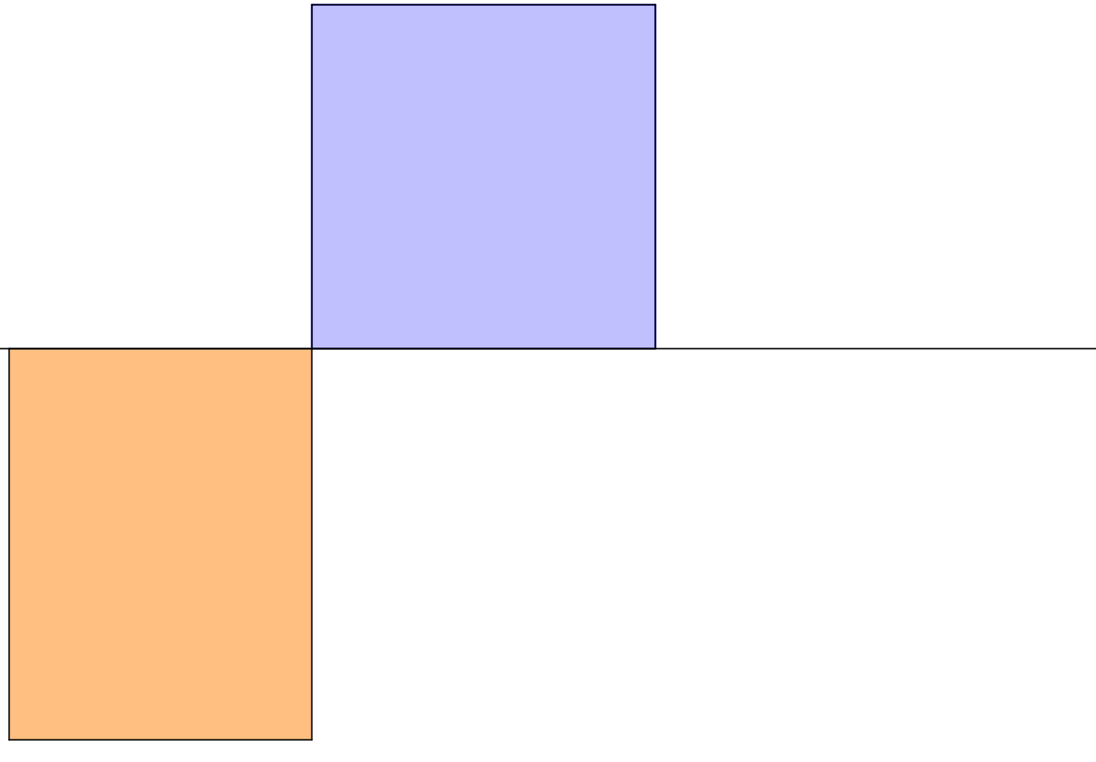

Slide 17
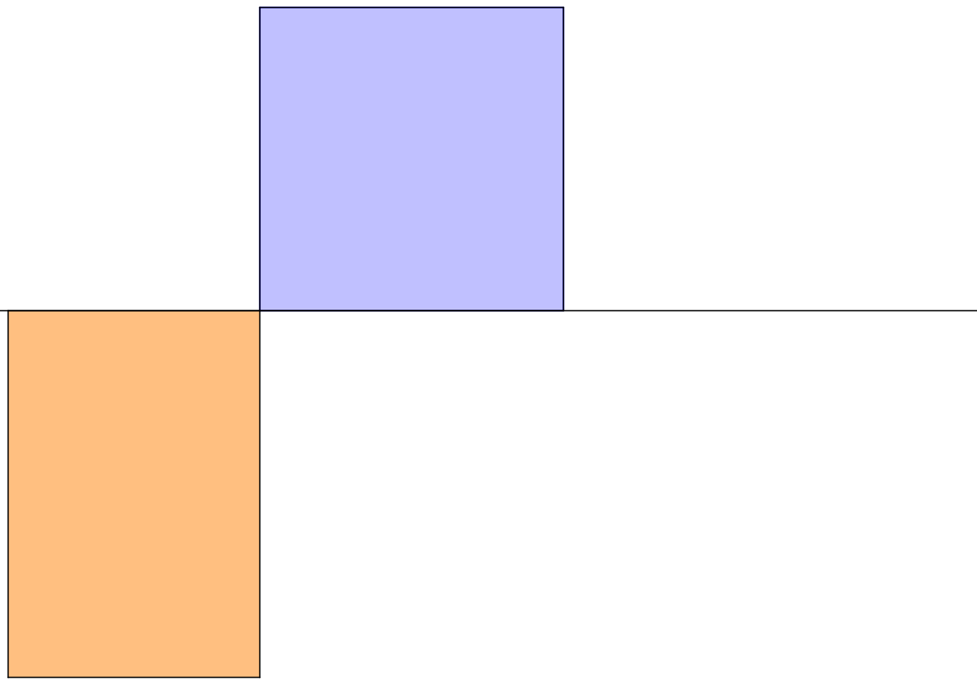

Slide 18
.
Focus on the black dot.

Slide 19
.
Focus on the black dot.

Slide 20
.
Focus on the black dot.

Slide 21
.
Focus on the black dot.

Slide 22
.
Focus on the black dot.

Slide 23
.
Focus on the black dot.

Slide 24
.
Focus on the black dot.

Slide 25
.
Focus on the black dot.

Slide 26
.
Focus on the black dot.

Slide 27
.
Focus on the black dot.

Slide 28
.
Focus on the black dot.

Slide 29
.
Focus on the black dot.

Slide 30
.
Focus on the black dot.

Slide 31
.
A trace on the black dot might help.

Slide 32
.
.

Slide 33
.
.
.

Slide 34
.
.
.
.

Slide 35
.
.
.
.
.

Slide 36
.
.
.
.
.
.

Slide 37
.
.
.
.
.
.
.

Slide 38
.
.
.
.
.
.
.
.

Slide 39
.
.
.
.
.
.
.
.
.

Slide 40
.
.
.
.
.
.
.
.
.
.

Slide 41
.
.
.
.
.
.
.
.
.
.
.

Slide 42
.
.
.
.
.
.
.
.
.
.
.
.

Slide 43
.
.
.
.
.
.
.
.
.
.
.
.
.

Slide 44





$$C$$
A
$$X$$
$$B$$
$$AX.BX=CX.DX$$
$$D$$

Slide 45
x
Mid-point of diameter

Slide 46



$$\sqrt{2}$$
$$1$$
$$1$$
Construct a square with area equal to the total area of the two quadrilaterals.

Slide 47






How would you determine the value of $\sqrt{6.25}$ by construction?
$$2.5$$
x
$$1$$
$$6.25$$
$$2.5$$
$1×6.25=2.5×2.5$
$6.25={2.5}^{2}$
$\sqrt{6.25}=2.5$

Slide 49
RESOURCES

Slide 50
SIC_46
Squaring the Rectangle
Square
Rectangle
Convince yourself that the two quadrilaterals have the same area.
Construct the square with area equal to the rectangle below using only a pencil, compass and straight edge.

Slide 52
SIC_46
Squaring the Rectangle
Square
Convince yourself that the two quadrilaterals have the same area.
Rectangle
Construct the square with area equal to the rectangle below using only a pencil, compass and straight edge.

Slide 53


Slide 54
SIC_46
Squaring the Rectangle
Square
Convince yourself that the two quadrilaterals have the same area.
Rectangle
Construct the square with area equal to the rectangle below using only a pencil, compass and straight edge.

Slide 55
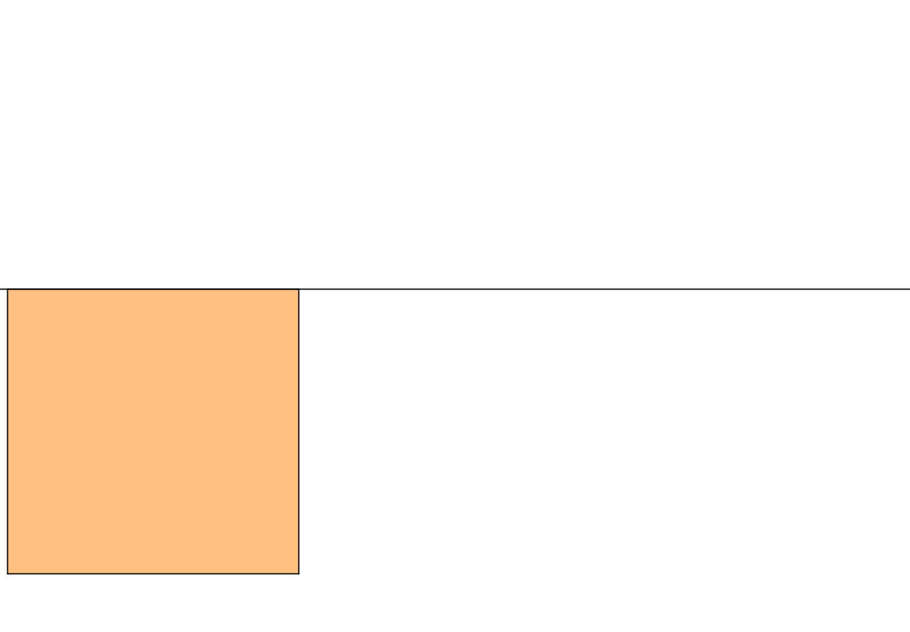

Slide 56
SIC_46
Squaring the Rectangle
Square
Rectangle
Convince yourself that the two quadrilaterals have the same area.
Construct the square with area equal to the rectangle below using only a pencil, compass and straight edge.

Slide 57
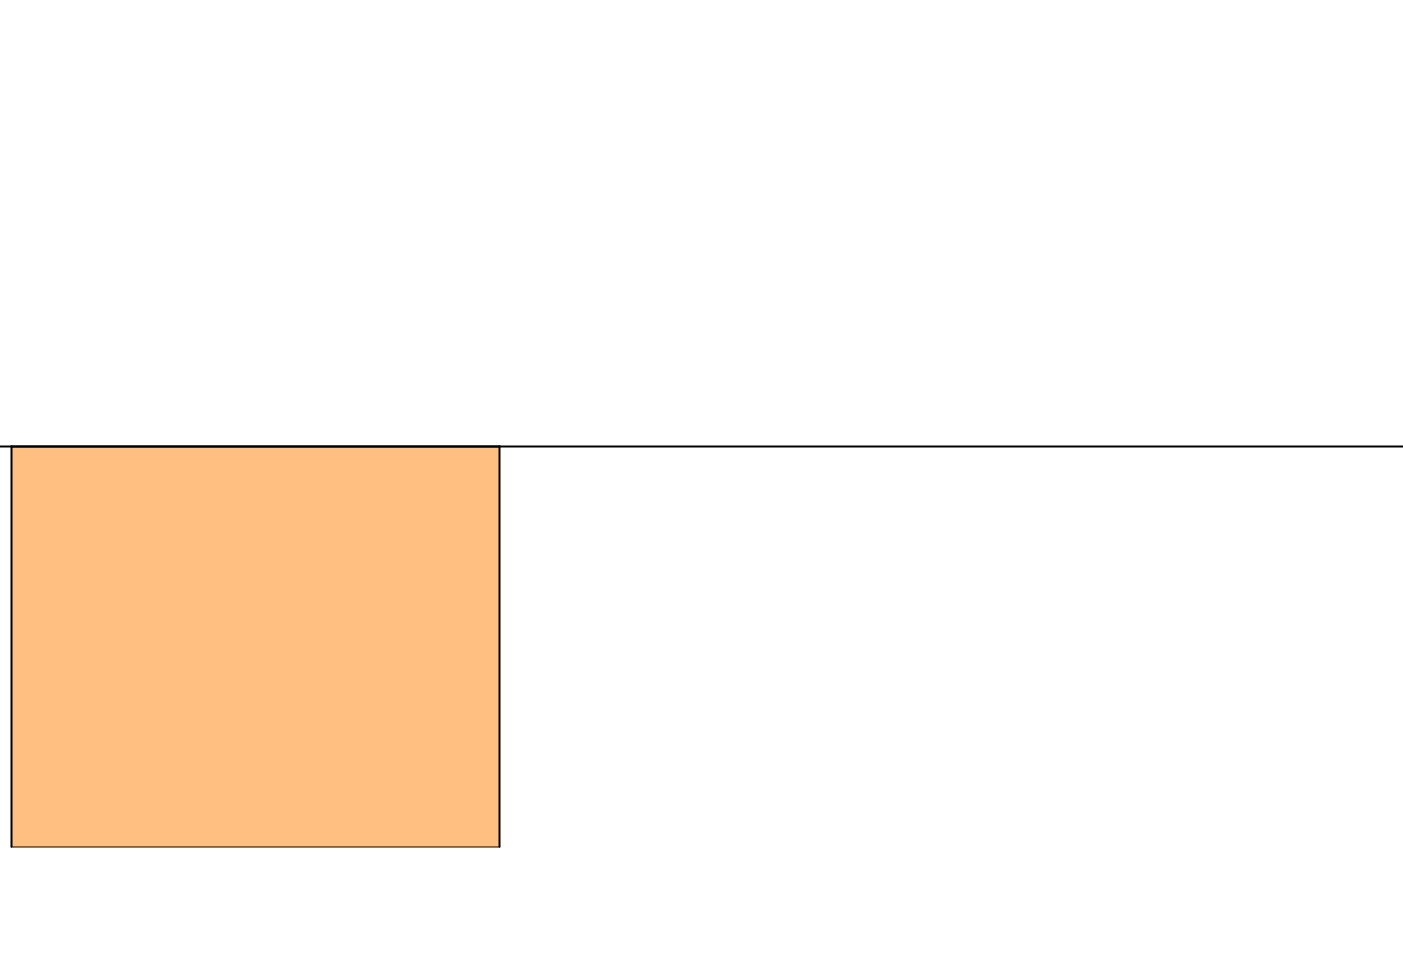

Slide 58
SIC_46
Squaring the Rectangle
Square
Rectangle
Convince yourself that the two quadrilaterals have the same area.
Construct the square with area equal to the rectangle below using only a pencil, compass and straight edge.

Slide 59
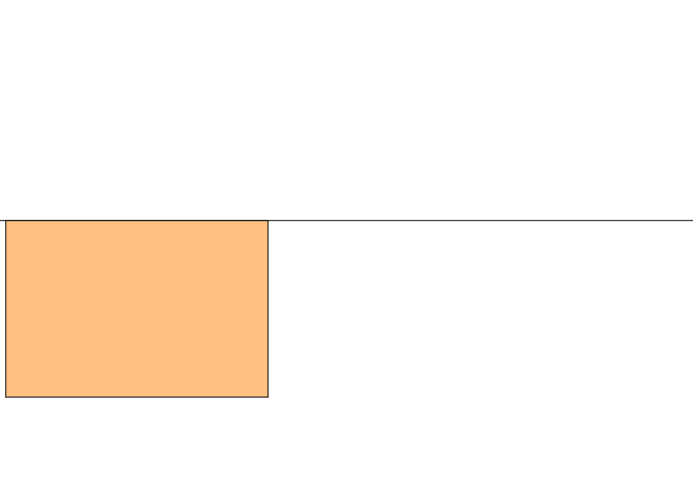

Slide 60
SIC_46
Squaring the Rectangle
Square
Rectangle
Convince yourself that the two quadrilaterals have the same area.
Construct the square with area equal to the rectangle below using only a pencil, compass and straight edge.

Slide 61
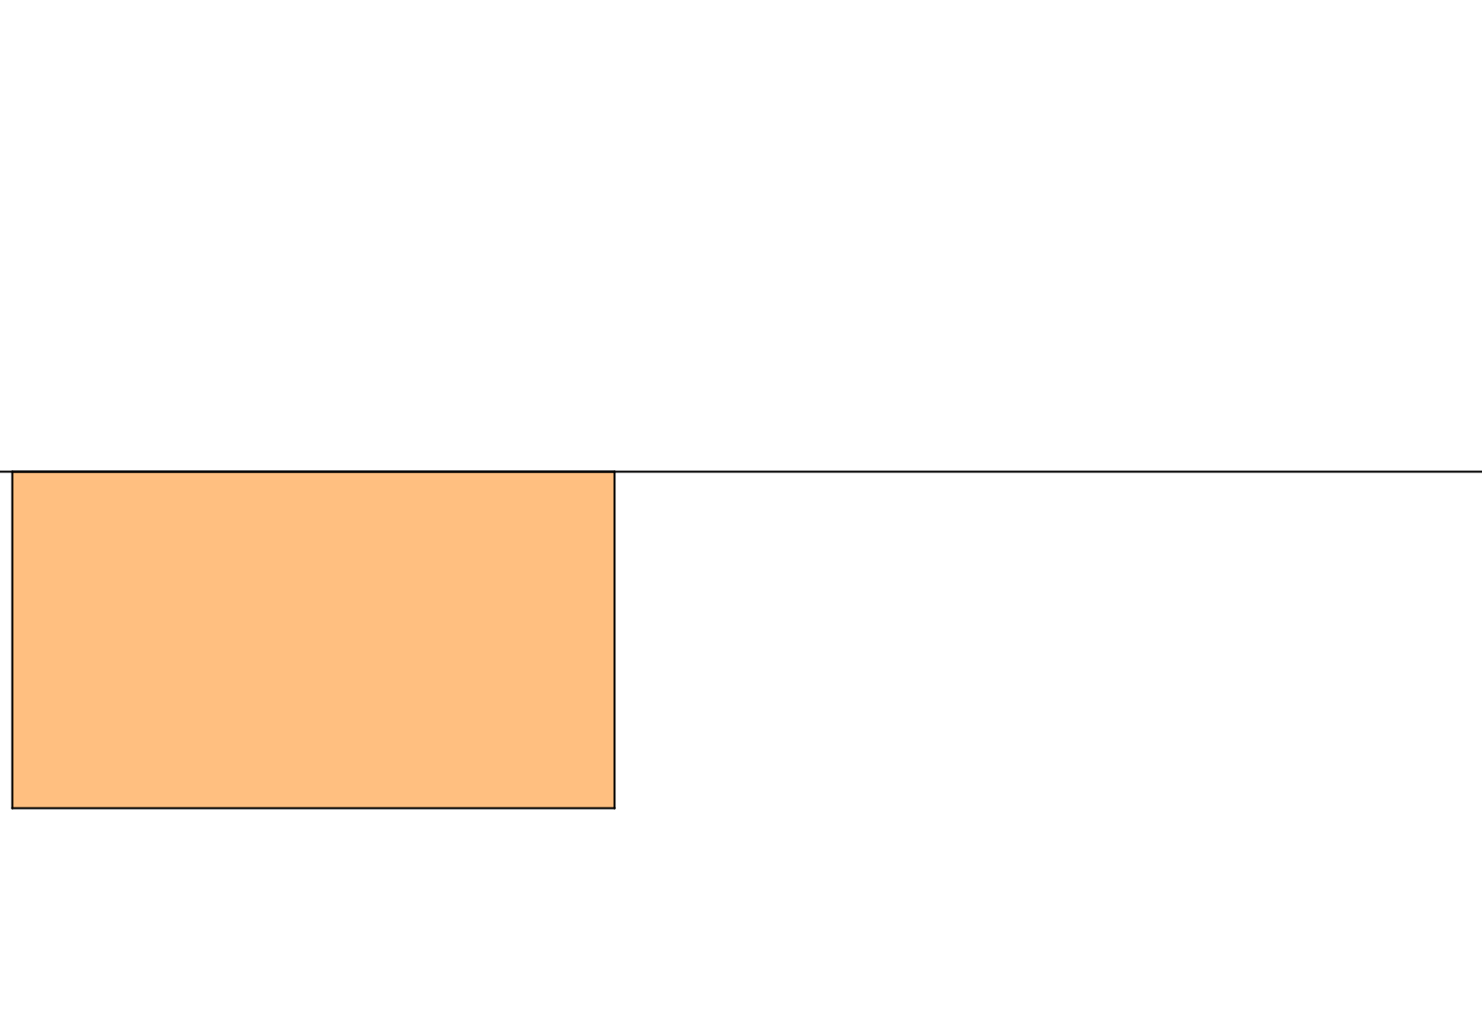

Slide 62
SIC_46
Squaring the Rectangle
Square
Rectangle
Convince yourself that the two quadrilaterals have the same area.
Construct the square with area equal to the rectangle below using only a pencil, compass and straight edge.

Slide 63
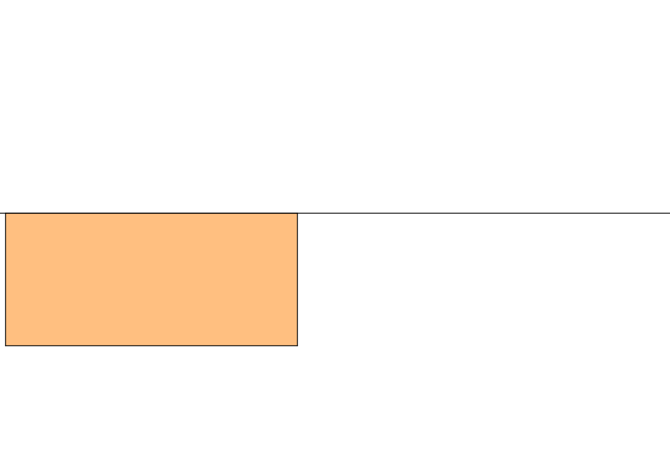

Slide 64
SIC_46
Squaring the Rectangle
Square
Rectangle
Convince yourself that the two quadrilaterals have the same area.
Construct the square with area equal to the rectangle below using only a pencil, compass and straight edge.

Slide 65
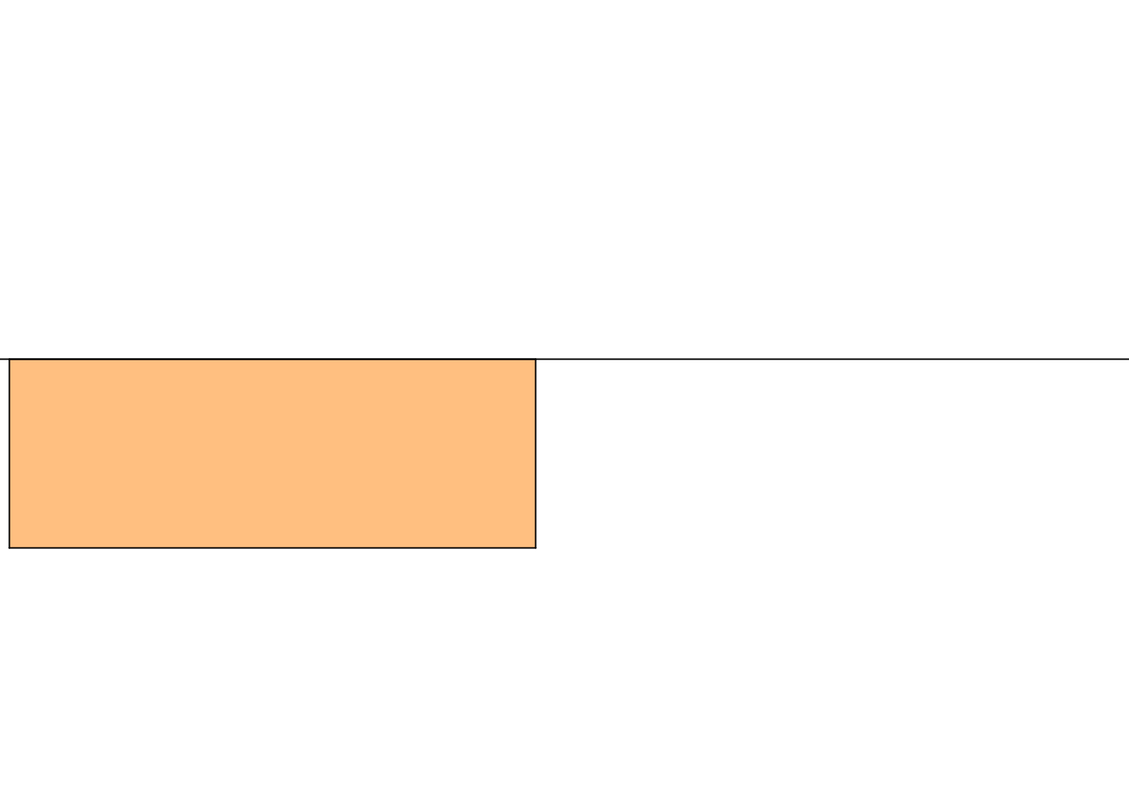

Slide 66
SIC_46
Squaring the Rectangle
Square
Rectangle
Convince yourself that the two quadrilaterals have the same area.
Construct the square with area equal to the rectangle below using only a pencil, compass and straight edge.

Slide 67
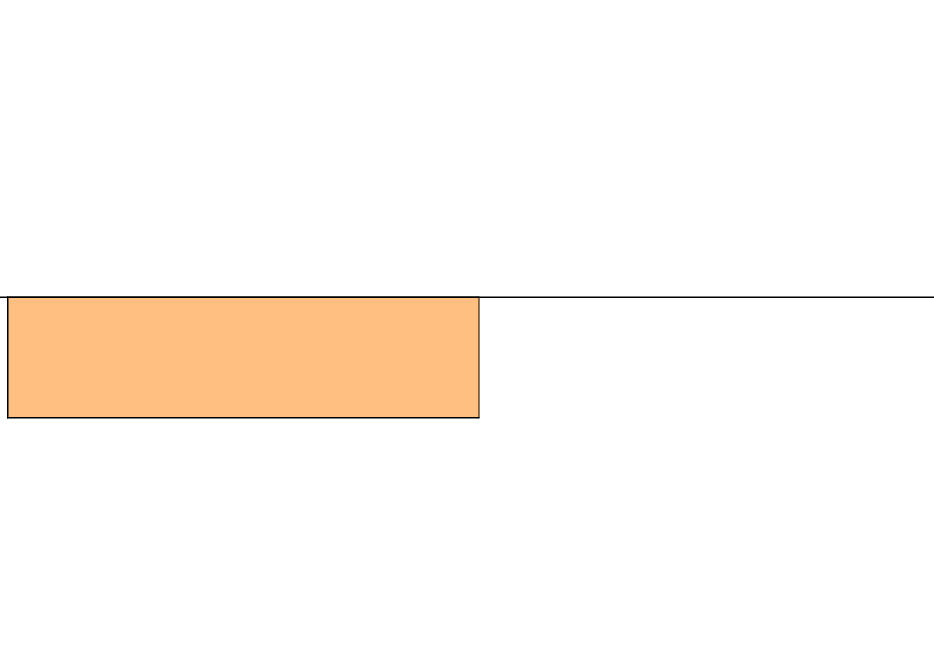

Slide 68
SIC_46
Squaring the Rectangle
Square
Rectangle
Convince yourself that the two quadrilaterals have the same area.
Construct the square with area equal to the rectangle below using only a pencil, compass and straight edge.

Slide 69


Slide 70
SIC_46
Squaring the Rectangle
Square
Rectangle
Convince yourself that the two quadrilaterals have the same area.
Construct the square with area equal to the rectangle below using only a pencil, compass and straight edge.

Slide 71
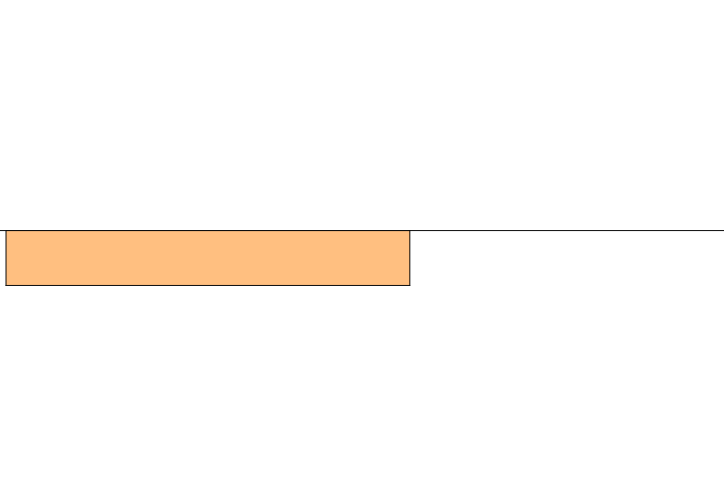

Slide 72
SIC_46
Squaring the Rectangle
Square
Rectangle
Convince yourself that the two quadrilaterals have the same area.
Construct the square with area equal to the rectangle below using only a pencil, compass and straight edge.

Slide 73
